Slide 1
Polygon Ninja

Slide 2
Game Overview & Design
Genre: Physics-based Slicing Game (Fruit Ninja clone).
Objective: Slice falling polygon objects.
Core Loop:
Spawn: Polygons spawn and fall under gravity.
Input: User drags mouse to create a "blade" trajectory.
Process: Engine detects intersections between the blade path and polygons.
Resolve: Polygons are split into smaller dynamic bodies; particles are emitted.

Slide 3
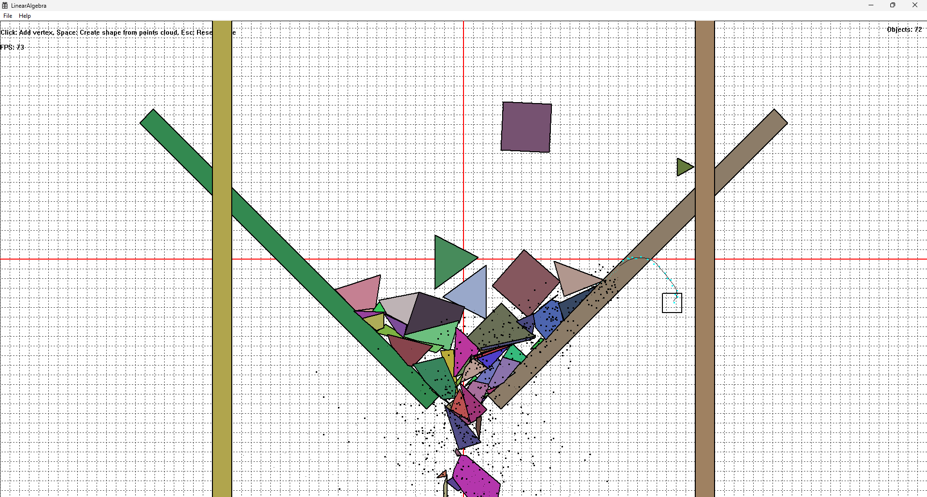

Slide 4
Level Design (The Hourglass)
Description: Instead of a simple open box, the level features a "funnel" or "hourglass" design to channel objects.
Implementation:
Defined in CreateHourglassLevel() in LinearAlgebra.cpp.
Constructed using static KBox shapes rotated at ±45 degrees.
Design Intent: This forces dynamic objects to cluster in the center, increasing collision frequency and making slicing multiple objects easier.

Slide 5
Slicing Logic (Math & Mechanics)
Concept: Slicing is not a single raycast but a history of points.
Algorithm (The "Out-In-Out" Rule):
Input Tracking: The mouse position is stored in g_swordPoints every frame to create a trail.
Intersection Check: The engine iterates backward through the sword history.
Entry/Exit Detection: It looks for a pair of points where one is outside the polygon and the immediate next one is inside (Entry), and later one is outside again (Exit).
Clipping: Uses the Sutherland-Hodgman algorithm (via ClipShape) to geometrically cut the polygon vertex list into two new lists.
Math Used:
Point-in-Polygon test (KVectorUtil::IsPointInPolygon).
Line Segment Intersection (LineSegementsIntersect).
Convex Hull generation (to ensure new shapes are valid physics bodies).

Slide 6
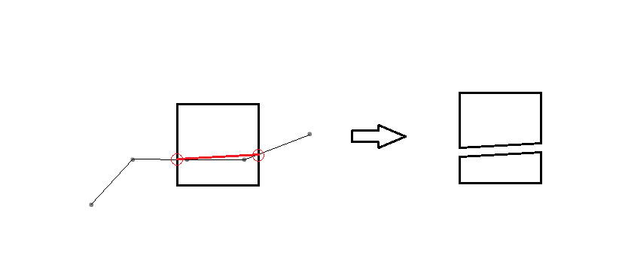
Contact point
Mouse Path
Contact point

Slide 7
Collision Optimization (Spatial Hashing)
Problem: Naive collision detection checks every object against every other object (O(N2)). With many sliced fragments, performance drops.
Solution: Spatial Hashing (Broad Phase).
Implementation:
Grid System: The world is divided into cells of size m_cellSize.
Hashing: A hash function maps 2D grid coordinates (x,y) to a 1D bucket index.
Insertion: Each frame, bodies are inserted into the buckets corresponding to their AABB (Axis-Aligned Bounding Box).
Retrieval: Collisions are only checked between bodies in the same bucket.
Impact: Reduces complexity closer to O(N) for sparse environments.
Key File: KSpatialHash.h.

Slide 8
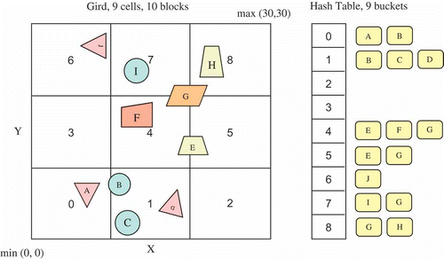

Slide 9
Rendering Optimization (GDI+)
Problem: Standard Windows GDI drawing is slow if GDI objects (Pens/Brushes) are created and destroyed every draw call.
Optimization 1: Pen Caching:
Implemented in KVectorUtil::DrawLine.
Static variables store the last used Pen. A new Pen is created only if the color, width, or style changes.
Optimization 2: Particle Batching:
Implemented in KParticleSystem::Draw.
Instead of drawing lines (which involves matrix math for every segment), particles are drawn as simple GDI Rectangle calls.
Uses DC_BRUSH to change colors quickly without object reallocation.

Slide 10
Visual Effects (Particle Systems)
Blade Trail:
Logic: A KParticleSystem is attached to the mouse input.
Behavior: Spawns red particles with zero velocity and short lifetime (0.5s) to visualize the cutting path.
Explosions/Sparks:
Trigger: Occurs exactly at the pEntry and pExit points calculated during the slicing phase.
Math: Particles use random velocity vectors derived from a rotation matrix (GetRandomDir) to simulate an outward burst.
Code Reference: ProcessSlicing() calls AddParticleSystem(pEntry).

Slide 11
Conclusion
Summary: The project successfully upgrades a basic physics engine into a game with interactive mechanics.
Key Takeaway: Optimization (Spatial Hash, Render Caching) was critical to support the increasing number of physics bodies generated by the slicing mechanic.

Slide 12
Thank You

